Slide 1
Machine Learning Algorithms Evaluations

Slide 2
Business Impact
Business Impact for SmartFleet Route Optimizer:
- Crime Prediction Model: Reduces incident-related costs by up to 20% ($562,710 for a 1500-vehicle fleet) by avoiding high-crime zones.
- Weather Risk Model: Enhances route efficiency, contributing to 20% fuel savings ($375,140) by avoiding adverse weather conditions.
- Sentiment Analysis LLM: Lowers risks from negative events, saving 10% ($187,570) by avoiding zones with reported unrest.
- Sensor Degradation Model: Optimizes maintenance, saving $27,000 annually by reducing downtime and repair costs.
- Composite Risk Model: Integrates all risks to achieve 40-80% risk avoidance, driving overall cost reductions of up to $1,406,775 annually.

Slide 3
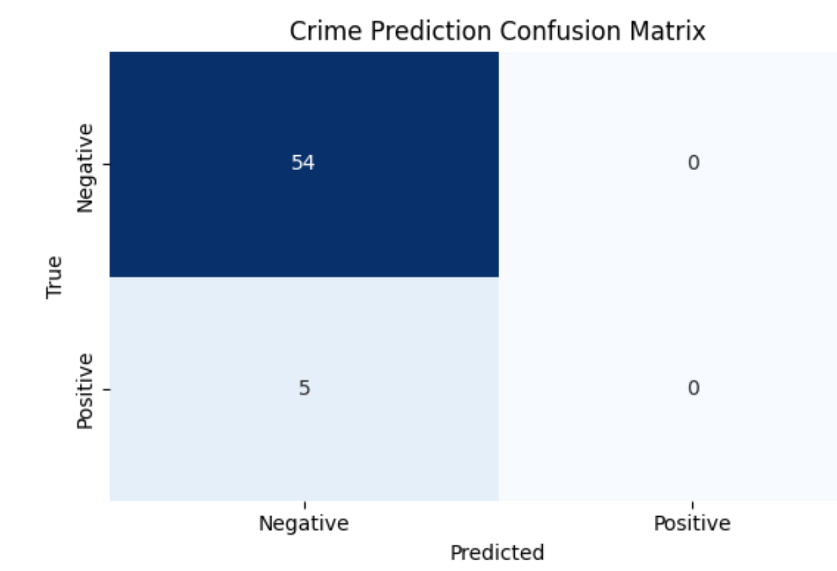
Crime Prediction

Slide 4
Crime Prediction

Slide 5
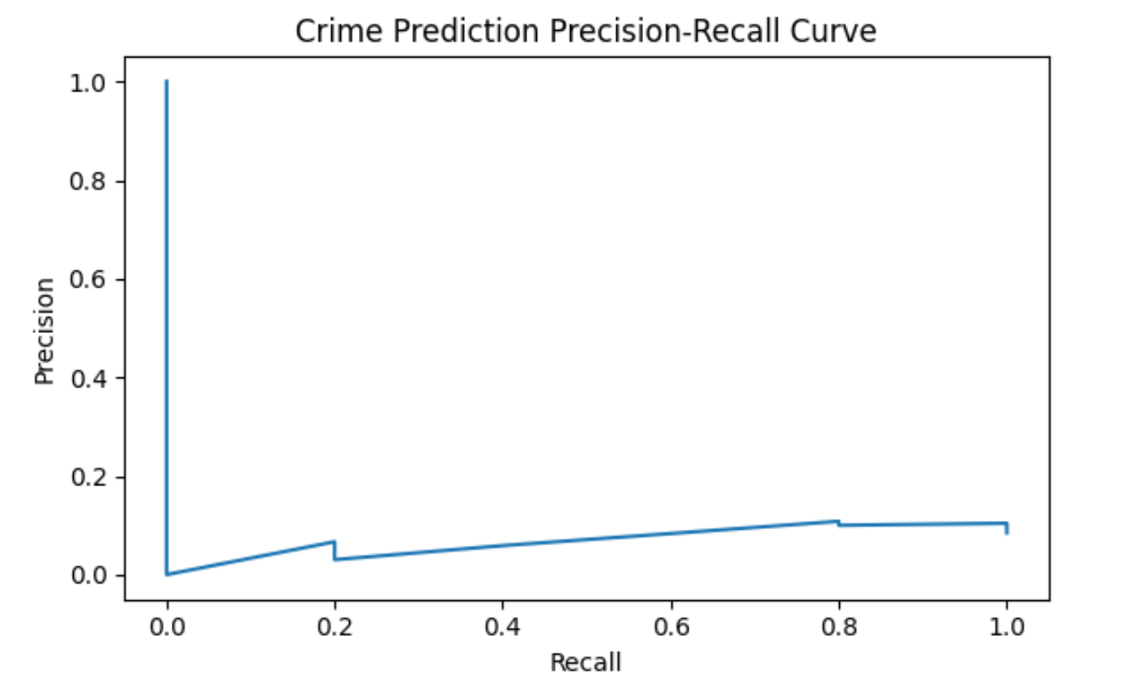
Crime Prediction

Slide 6
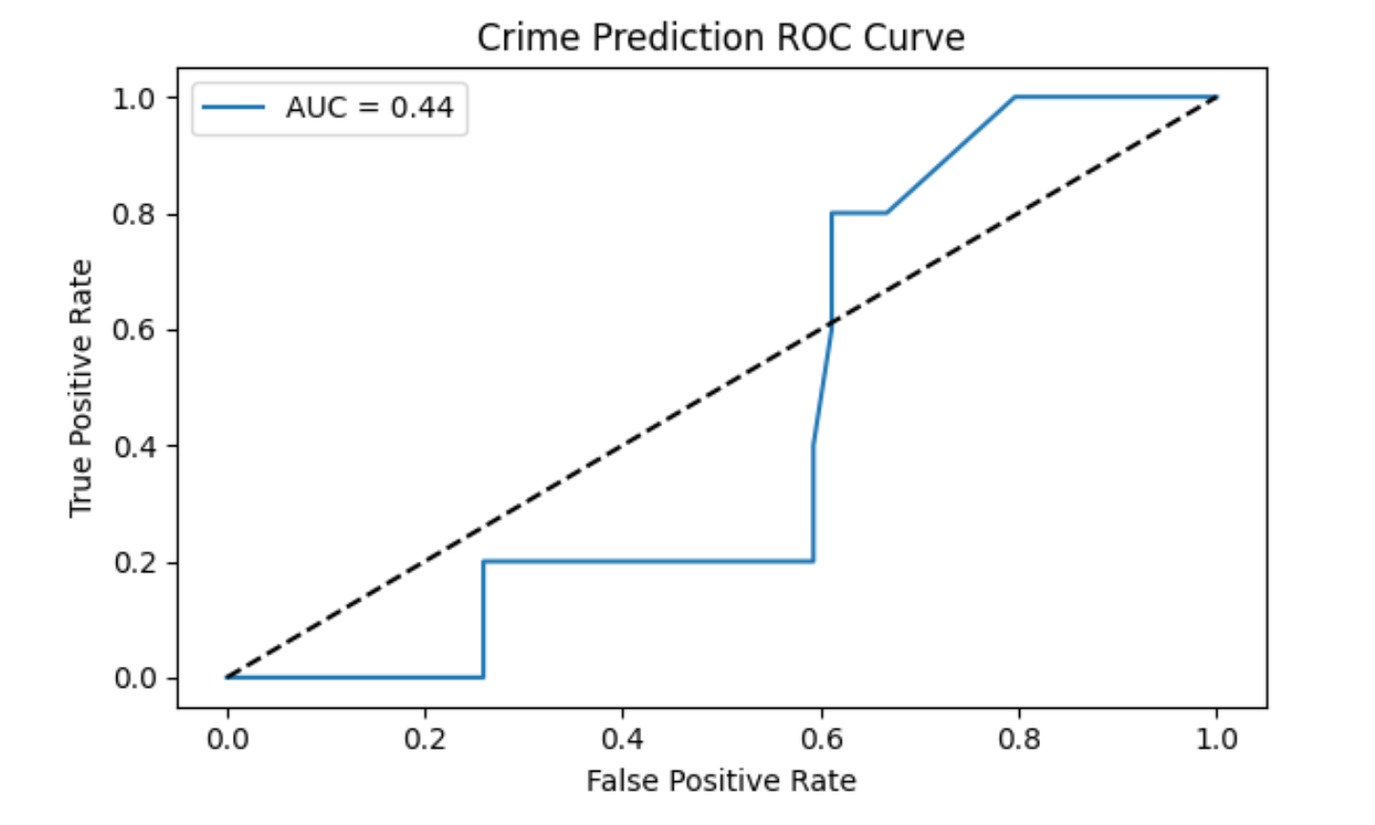
Crime Prediction

Slide 7
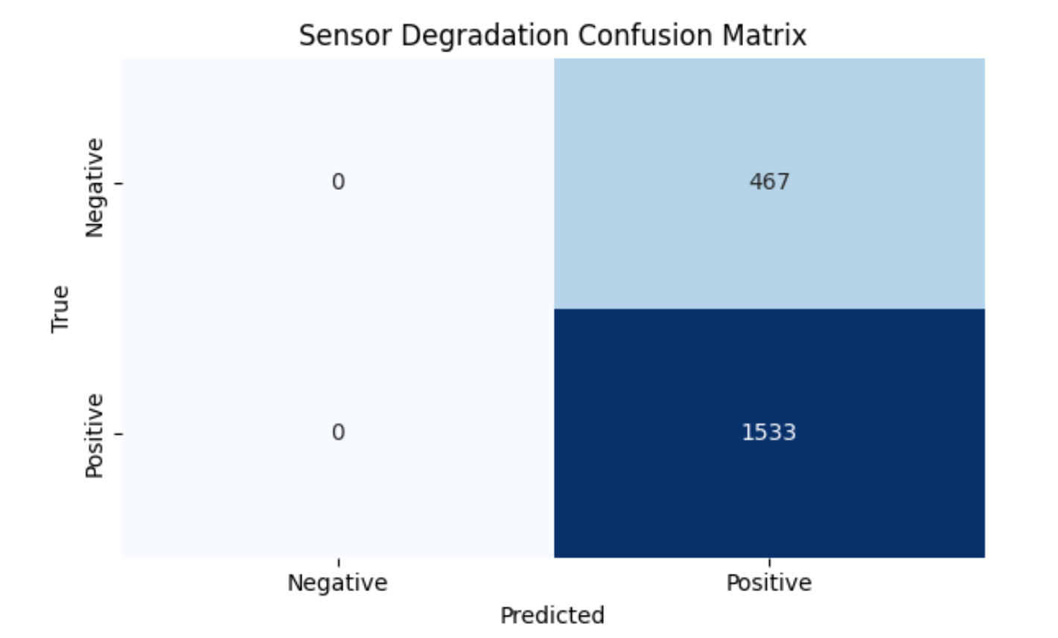
Sensor Evaluation

Slide 8
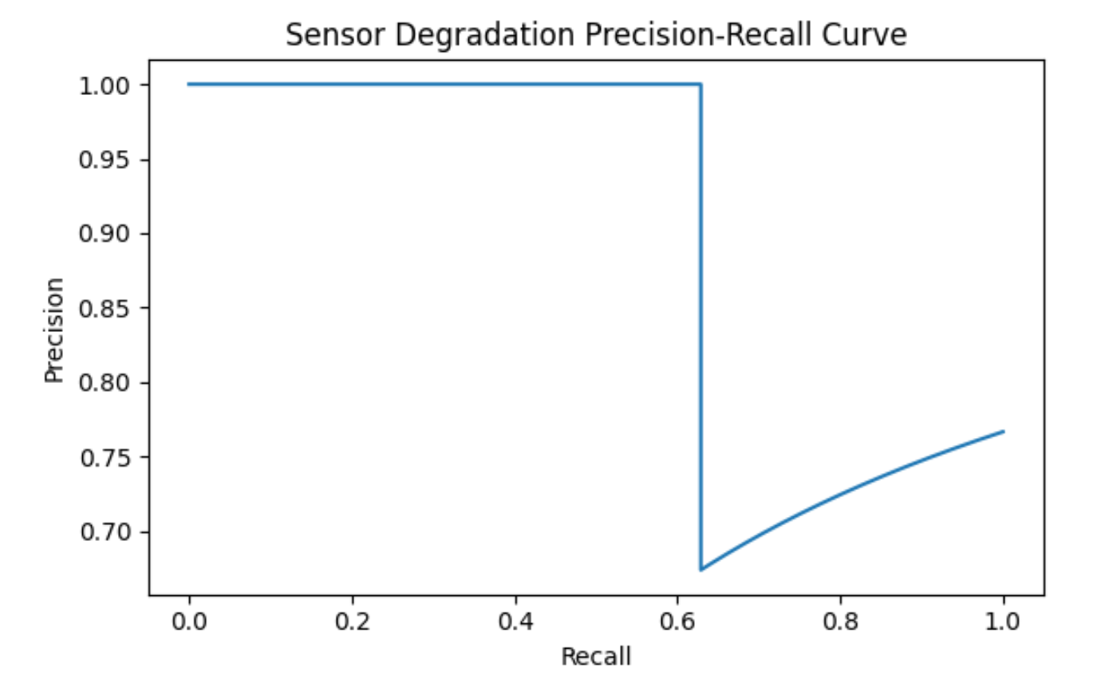
Sensor Evaluation

Slide 9
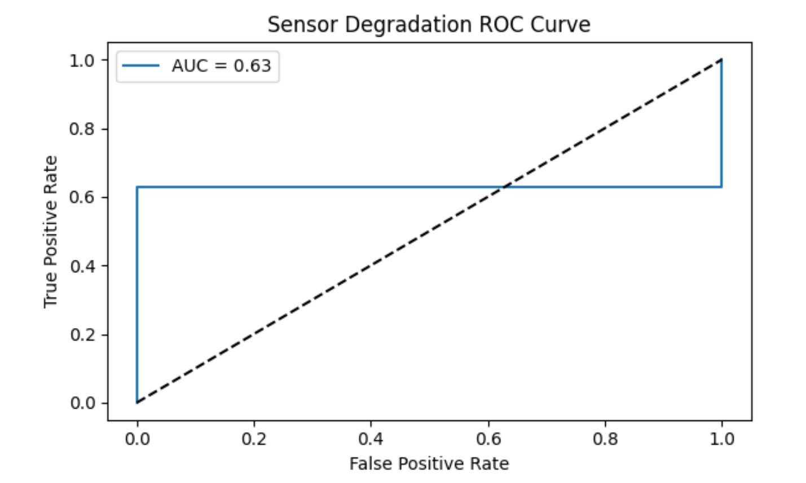
Sensor Evaluation

Slide 10
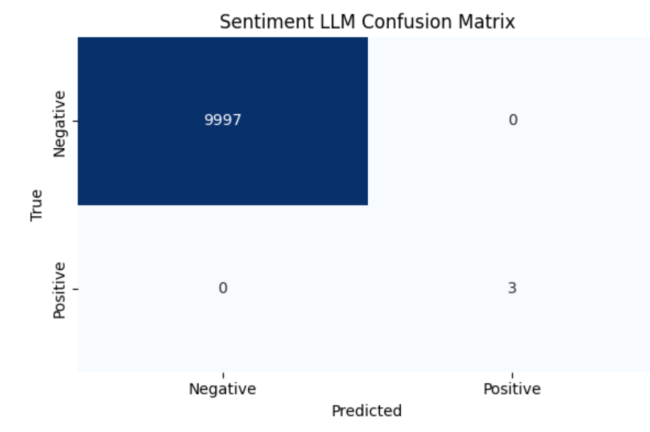
News Sentiment

Slide 11
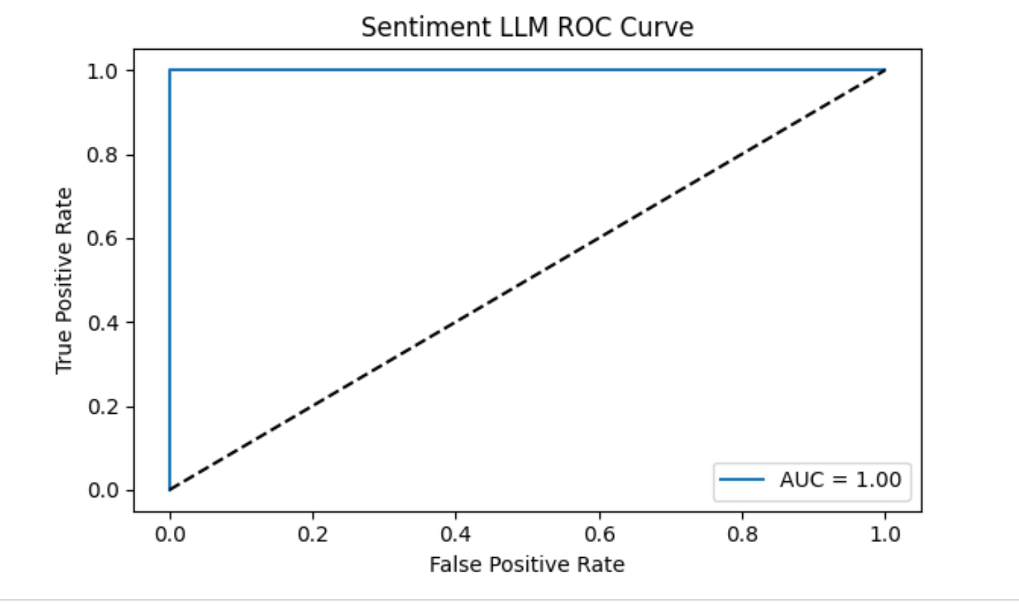
News Sentiment --- I THINK THIS IS WRONG

Slide 12
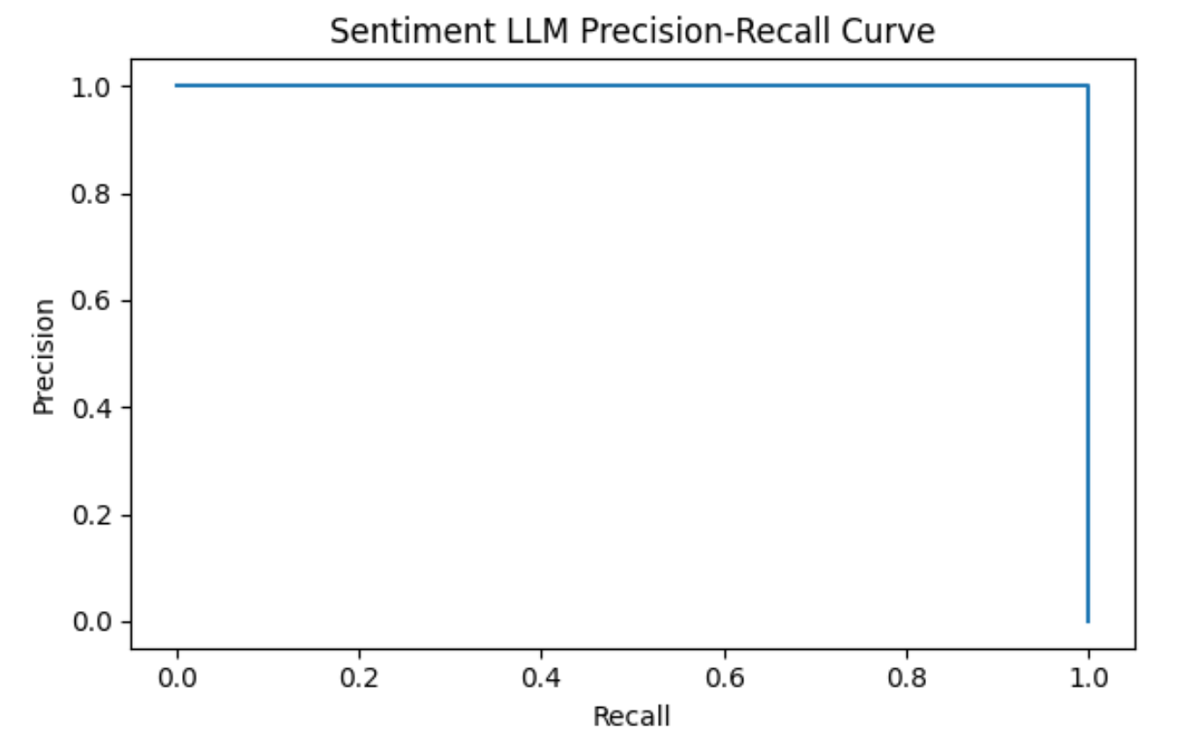
News Sentiment --- I THINK THIS IS WRONG

Slide 13
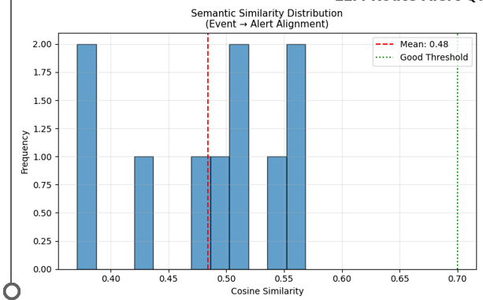
News Sentiment

Slide 14
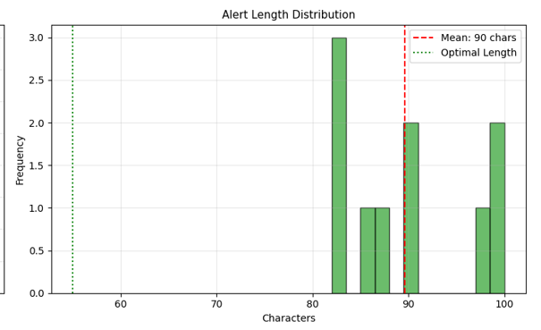
News Sentiment

Slide 15
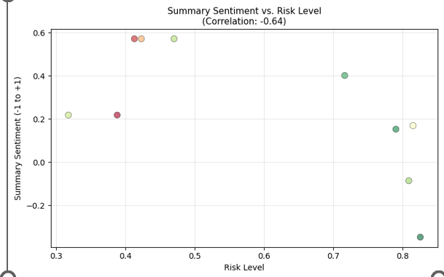
News Sentiment

Slide 16
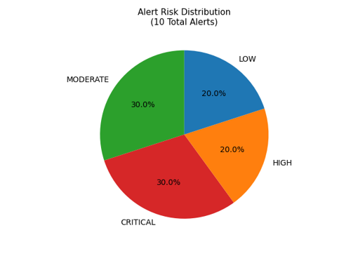
News Sentiment

Slide 17
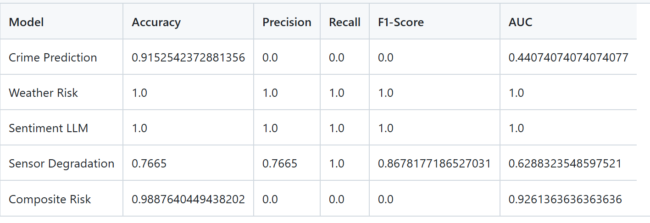
Metrics

Slide 18
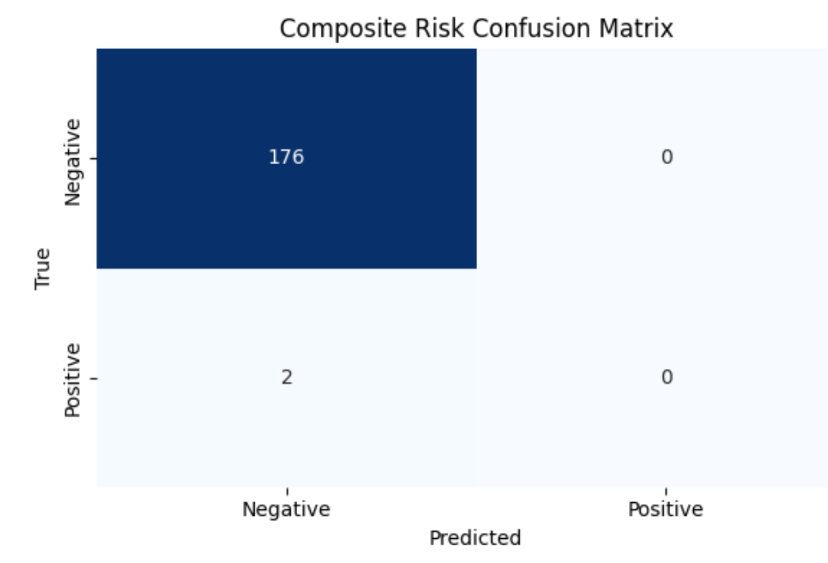
Composite Risk

Slide 19
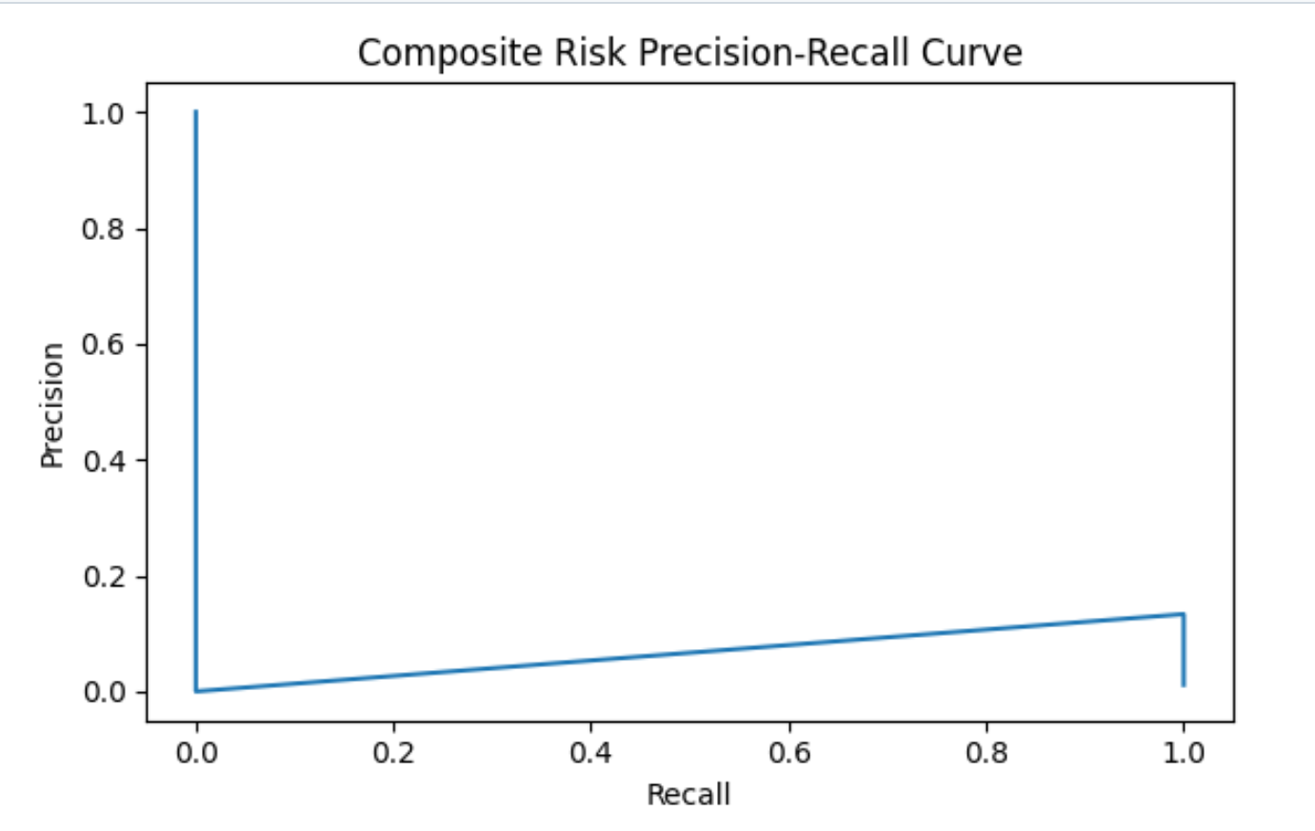
Composite Risk

Slide 20
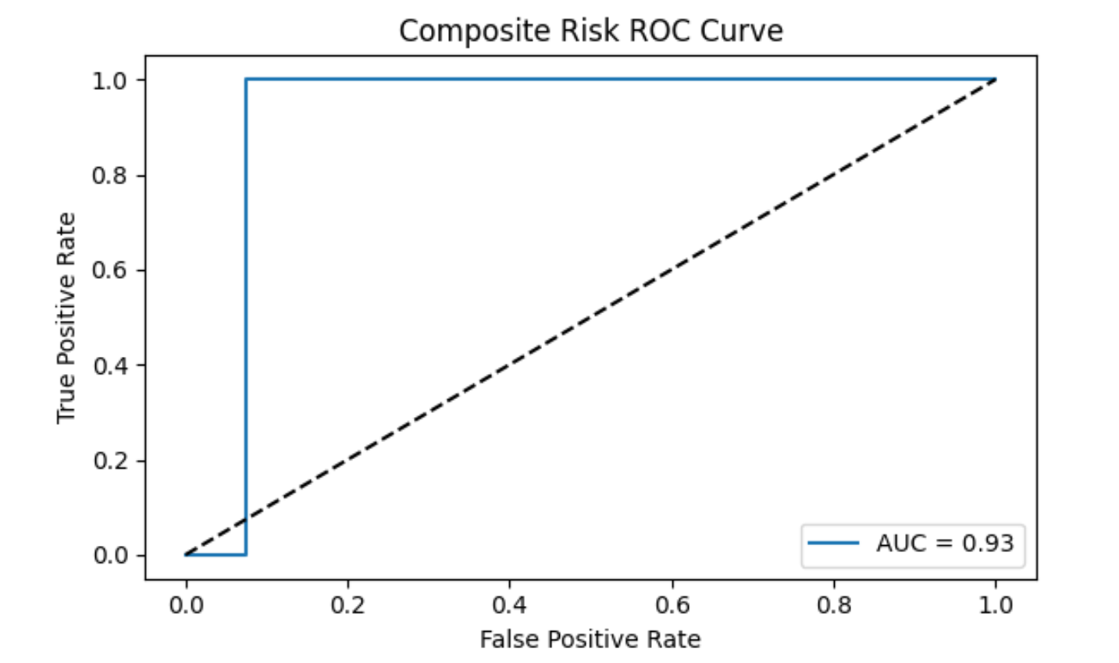
Composite Risk

